Slide 1
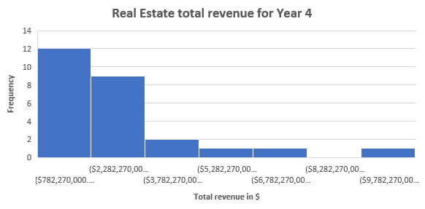
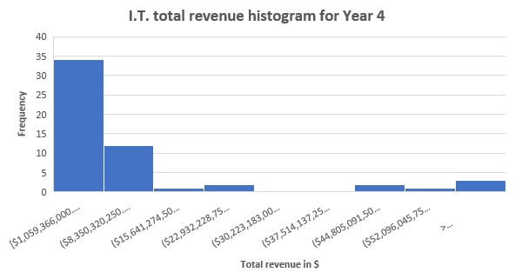
Does Real Estate Sector have similar total revenue in comparison to I.T. Sector in Year 4?
The histograms here compares between the similarity in total revenue for I.T. Sector and Real Estate for all companies in Year 4.
Both distributions are right skewed or positively skewed which implies that the mean is greater than the median.
The range for I.T. Sector ($214,579,634,000.00) is more substantial than Real Estate Sector ($10,073,540,000.00) which means that there is larger difference between companies in the IT sector than in real estate. Larger values in the IT sector indicates that this sector has higher variability than real Estate.
The standard deviation for real estate is also larger than IT sector (2.3 billion for real estate and 34 billion for IT sector. As the standard deviation is a spread measure, it indicates that the company spread is more in IT sector as its standard deviation is higher than real estate. The mean for IT sector is about $16 billion whereas for real estate the mean is $2.8 billion. The median for IT is double the median of real estate ($5.5 billion for IT and $2.5 billion for real estate). According to statistics mentioned, it shows that the total revenue of IT sector is much higher than the real estate.

